Slide 1
JEYASRI P
Final Project
3/21/2024 Annual Review

Slide 2
PROJECT TITLE
DATA AUGMENTATION USING TIME SERIES
3/21/2024 Annual Review

Slide 3


AGENDA
Problem Statement
Project Overview
Who are the end users?
Solutions and value of propositions
WOW factor in the solution
Modelling
Results
3/21/2024 Annual Review

Slide 4

PROBLEM STATEMENT
Data augmentation is a critical technique in machine learning, particularly for tasks involving time series data. Time series data often exhibits complex patterns and dependencies, and the performance of machine learning models trained on such data can be greatly improved by augmenting the training dataset with additional synthetic samples. However, designing effective data augmentation techniques specifically tailored to time series data presents unique challenges.
3/21/2024 Annual Review

Slide 5

PROJECT OVERVIEW
The aim of data augmentation using time series data is to enhance the robustness, generalization, and performance of machine learning models trained on such data by increasing the diversity and size of the training dataset through the generation of synthetic samples.
The training dataset with diverse and realistic samples, thereby enhancing the learning process and improving the performance of machine learning models on various time-dependent tasks such as forecasting, anomaly detection, classification, and regression.
3/21/2024 Annual Review

Slide 6

WHO ARE THE END USERS?
The end users for data augmentation using time series data encompass a broad spectrum of individuals and organizations involved in machine learning and data analytics, particularly those working on tasks that rely on time-dependent data. Deploying machine learning models, who leverage data augmentation techniques to improve the robustness and performance of their models trained on time series data. In various industries, including finance, healthcare, manufacturing, and energy, who utilize machine learning models for tasks such as forecasting demand, detecting anomalies, optimizing processes, and making data-driven decisions based on time series data.
3/21/2024 Annual Review

Slide 7

YOUR SOLUTION AND ITS VALUE PROPOSITION
1.Enhanced Model Performance: By generating diverse and realistic synthetic samples, the augmentation techniques improve the generalization and robustness of machine learning models trained on time series data.
2.Improved Model Robustness: The augmented datasets help models become more resilient to noise, outliers, and variations in the input data, resulting in models that are better equipped to handle real-world scenarios and unexpected changes in the environment.
3.Reduced Overfitting: Data augmentation mitigates the risk of overfitting by expanding the training dataset with augmented samples, thereby preventing the model from memorizing specific instances and enabling it to learn more generalized patterns and trends.
4.Scalability and Efficiency: The augmentation techniques are designed to be computationally efficient and scalable, making them suitable for processing large-scale time series datasets commonly encountered in real-world applications.
3/21/2024 Annual Review

Slide 8

THE WOW IN YOUR SOLUTION
The "wow" factor in our solution for Data augmentation using time series data lies in its ability to unlock the full potential of machine learning models by harnessing the richness and complexity of temporal data. Our solution intelligently preserves the intricate temporal dynamics present in time series data, ensuring that augmented samples accurately capture the underlying patterns, trends, and dependencies. This dynamic preservation facilitates more effective learning and enables models to make accurate predictions even in highly dynamic environments. This realism enhances the trustworthiness of the trained models and minimizes the risk of introducing biases or artifacts into the learning process, ultimately leading to more accurate and trustworthy predictions. We prioritize seamless integration and efficiency, ensuring that our augmentation techniques can be easily incorporated into existing machine learning workflows and pipelines without introducing significant computational overhead.
3/21/2024 Annual Review

Slide 9
MODELLING
1.Data Collection: Data collection for data augmentation using time series data involves gathering a diverse and representative set of time series datasets relevant to the target domain or application.
2. Data Preprocessing Apply smoothing or filtering techniques to remove noise and fluctuations from the time series data .
3. Model Development: Consider models such as recurrent neural networks (RNNs), long short-term memory (LSTM) networks, gated recurrent units (GRUs), convolutional neural networks (CNNs).
4. Model Training: Split the augmented dataset into training, validation, and test sets, ensuring that each set preserves the temporal integrity and relevance of the data.
5. Model Evaluation: Evaluation metrics for time series tasks include mean squared error (MSE), mean absolute error (MAE), accuracy, precision, recall, F1 score .
6. Prediction on New Data: Apply the prediction model to sequential or streaming data to make real-time predictions as new data becomes available, enabling timely insights and decision-making.
7. Tools and Libraries: Utilize Python with TensorFlow and Keras for deep learning, OpenCV for image processing, PIL for image analysis, and Matplotlib for visualization.
3/21/2024 Annual Review

Slide 10
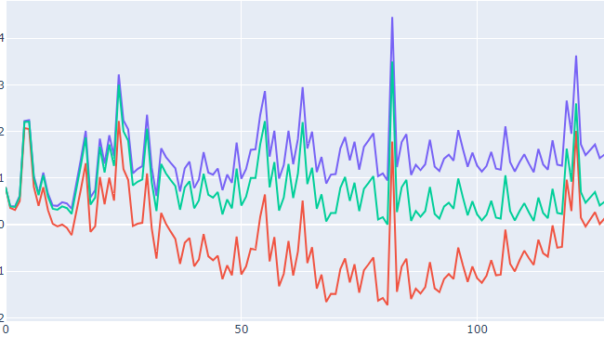
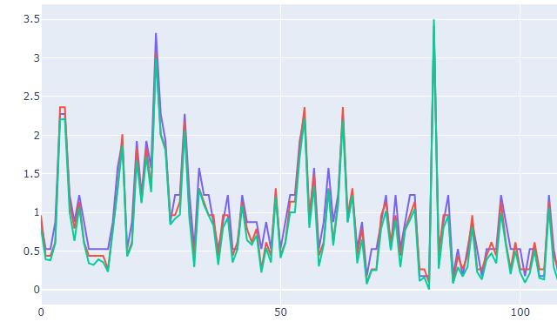
RESULTS
3/21/2024 Annual Review

